Slide 1
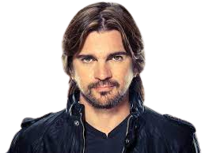


Juan Esteban Aristizábal Vásquez
Worldwide
Sings and Produces
“Juanes”

Slide 2

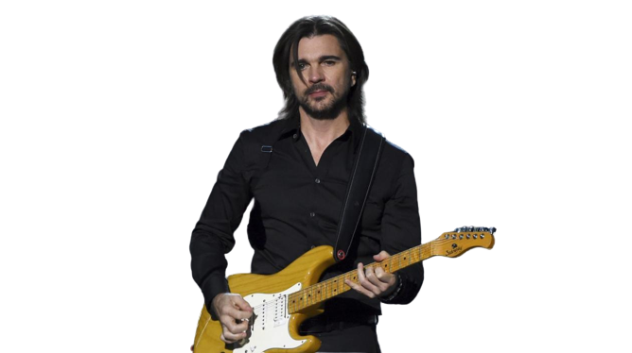
PLACE OF BIRTH

Slide 3
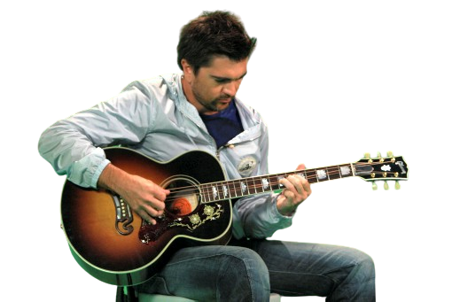
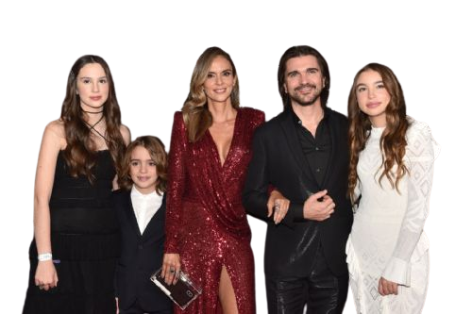
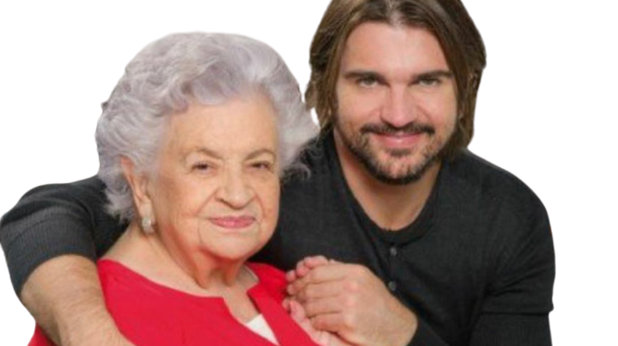


FAMILY history
Alicia Vásquez
Karen Martínez
Learned to play guitar
He was farmer

Slide 4

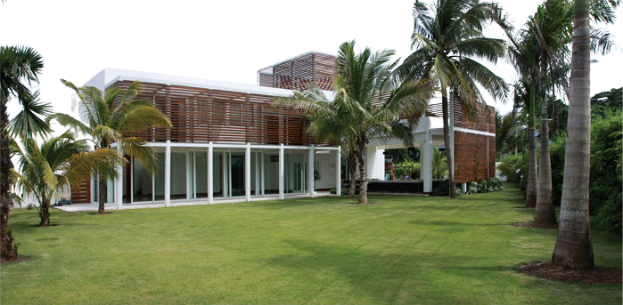


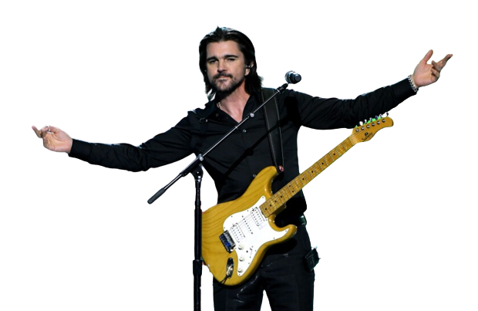


Place of residence

